Slide 1
Theoretical Aspects of Black hole-Galaxy Interaction
2014-02-10/12 SSG Workshop, 무주
박명구 (경북대학교 천문대기과학과)

Slide 2
I. Observational Facts
SMBHs exist in all galaxies, esp. with spheroids
  Kormendy & Richstone 1995
  Richstone et al. 1998
  Methods
    Detailed dynamical modeling that fits velocity dispersion and rotational velocity to prove BH existence.
    Maser
    Reverberation mapping

Slide 3
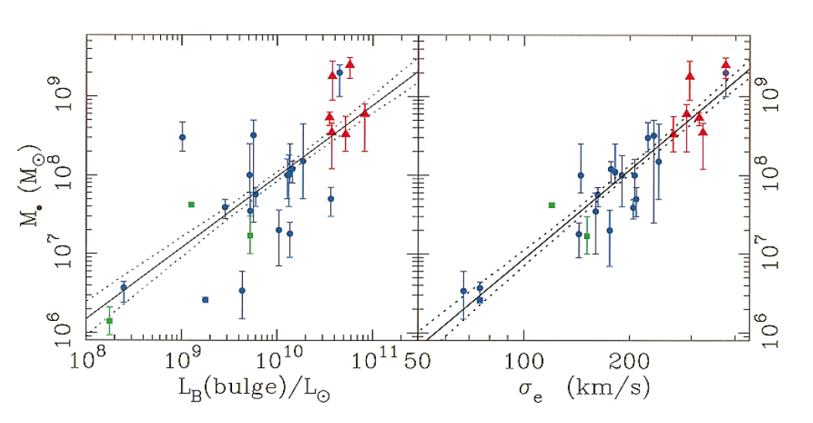
M_{BH} - σ relation
  Gebhardt et al. 2000

Slide 4
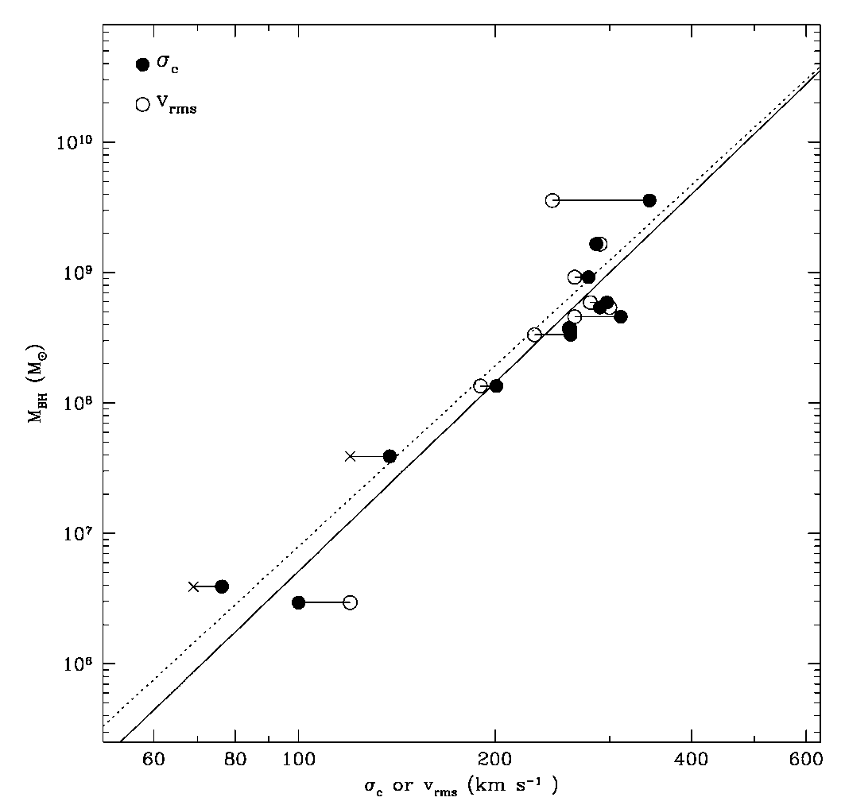
  Ferrarese & Merritt 2000
    BH mass from
    gas & stellar spectra,
    proper motion,
    masers

Slide 5
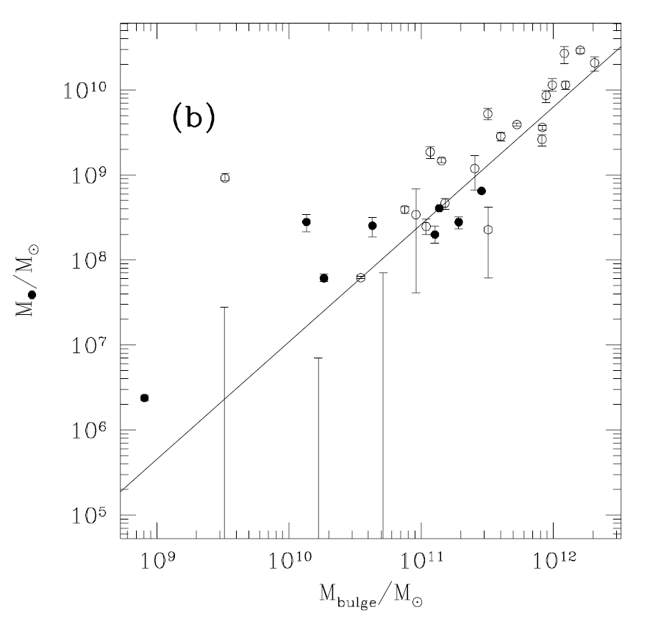

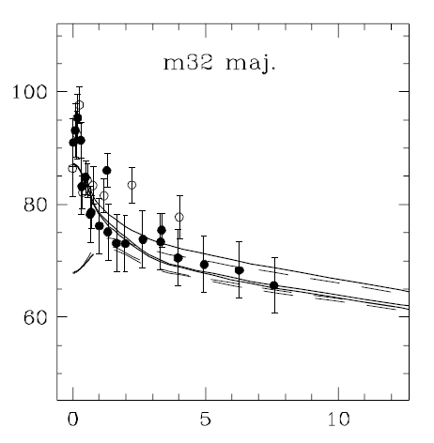
M_{BH} – Bulge stellar mass
  Magorrian et al. 1998

Slide 6
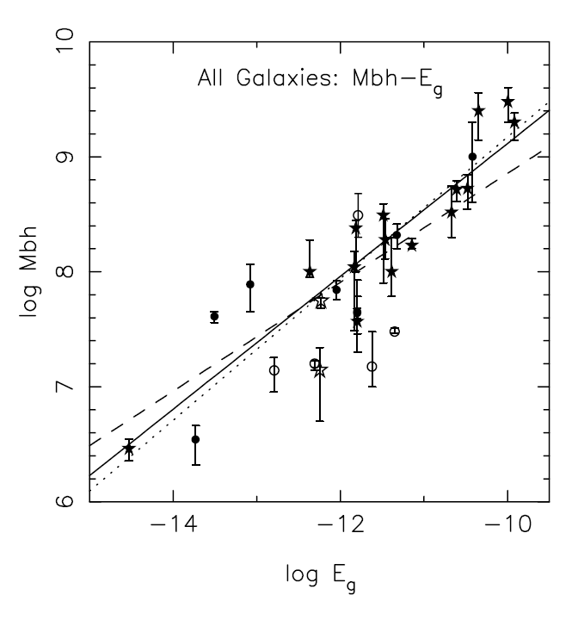
M_{BH} – Bulge binding energy
  Aller & Richstone 2007

Slide 7
II. BH – Galaxy Coevolution
Growth of BH
  Seed BH
    Population III stars (Volonteri et al. 2003)
    Direct collapse of gas (Loeb & Rasio 1994)
  By accretion
    merger triggered accretion
    secular evolution by stellar evolution
  BH – BH merging
    repeated merges of galaxies lead to merging of central BHs, especially at low redshifts
    galaxy merging to BH merging proceeds by dynamical friction
    BH-BH merger can lose mass via gravitational radiation
    BH ejection by gravitational wave recoils
    orbiting and ejected BHs may exist

Slide 8
Feedback from SMBH
  Winds
    radiatively driven (Park & Ostiker 1999)
    mechanically driven (Proga et al. 2000)
  Radiation
    radiative heating/photoionization (Ciotti & Ostriker 2007)
    radiation pressure (DeBuhr et al. 2010)
  Thermal feedback
    unknown mechanism (Springel et al. 2005)

Slide 9

III. Prescriptions in Numerical Simulations
Mass accretion rate
  proportional to star formation rate
  Bondi accretion rate
  $${\dot{M}}_{accretion}={\dot{M}}_{B}=4πΛ(γ)\frac{G^{2}M^{2}ρ_{∞}}{γ^{3/2}{c^{3}}_{s,∞}^{}}$$
  Maximum accretion rate: Eddington rate
  $${\dot{M}}_{Edd,r}≡\frac{L_{Edd}}{ε_{r}\dot{M}c^{2}}$$

Slide 10

Luminosity by SMBH
  $$L\sim ε\dot{M}c^{2}$$
  fixed radiation efficiency
Thermal/Wind feedback
  $$\dot{E}\sim ε_{f}{\dot{M}}_{accretion}c^{2}$$
  fixed fraction of radiation output
BH formation
  assumed to be a fraction of stellar mass
BH merging
  BHs merge after dynamical time

Slide 11

IV. View from Accretion Theory
Scale problems
  galaxy simulation scale ≥ 10? pc
  accretion radius
    $r_{B}≡\frac{GM}{c_{s,∞}^{2}}=2.5\left(\frac{M}{{10}^{7}M_{s}}\right){\left(\frac{T}{{10}^{6}K}\right)}^{−1}$pc
    accretion flow structure determined in scales less than this, sometimes much less
  unresolved in numerical simulations, probably for some time

Slide 12

Radiative efficiency of BH accretion
  depends on the mode of accretion
  $$0≲ε≡\frac{L}{\dot{M}c^{2}}≲0.1$$
  dimensionless mass accretion rate
  $\dot{m}≡\frac{\dot{M}}{{\dot{M}}_{Edd}},$ ${\dot{M}}_{Edd}≡\frac{L_{Edd}}{\dot{M}c^{2}}$

Slide 13
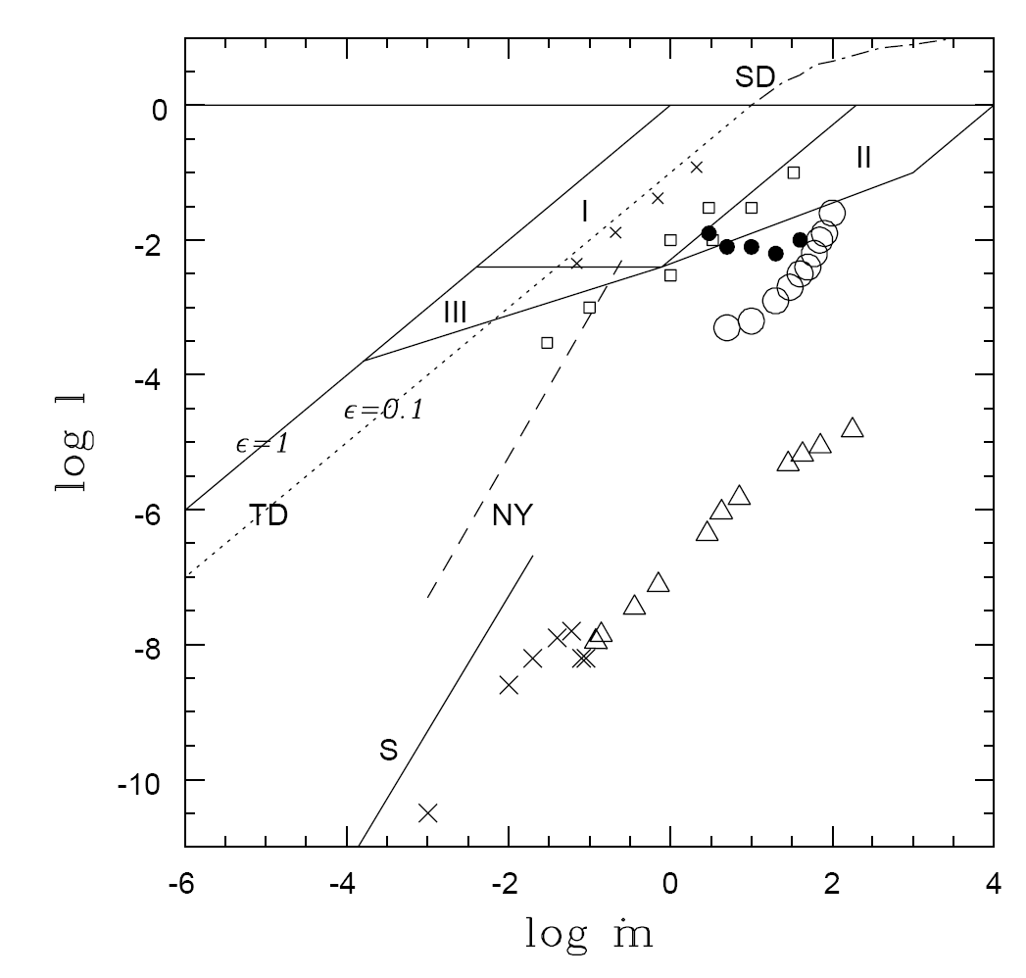
luminosity vs mass accretion rate

Slide 14
luminosity vs radiation efficiency

Slide 15
Mode of accretion
angular momentum
Hot
Bondi
Shapiro
ADAF/CDAF
Narayan-Yi
T
Warm
Park
Polish Donut
Paczynski
Cold
Flammang
Slim Disk
Abramowicz
Thin Disk
Shakura-Sunyaev
H/R
1

Slide 16

Outflow
  outflow seems to be ubiquitous in hot radiatively inefficient accretion flow
  radiative momentum driven
    $L \sim L_{E}$
  radiative heating driven
    $L <L_{E}$ (Park & Ostriker 1999, 2001, 2007)
  mechanically driven

Slide 17
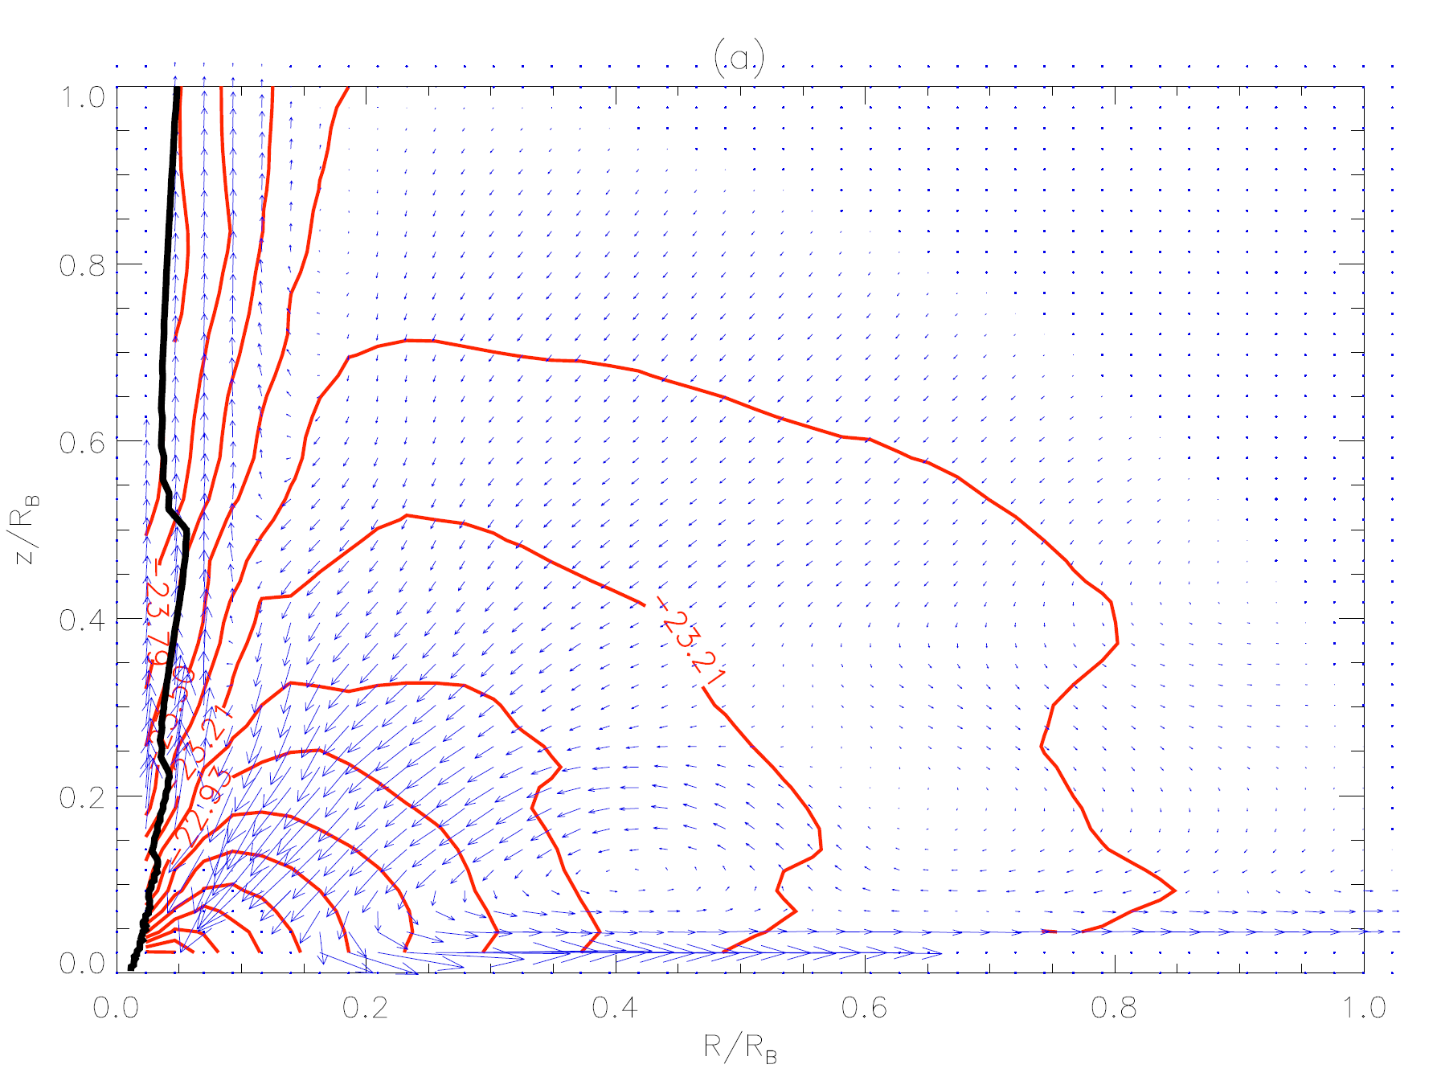
polar outflow
equatorial outflow
Li, Ostriker, Sunyaev 2013

Slide 18

Accretion Rate
  $J=0$ flow (Bondi accretion rate)
  $${\dot{M}}_{B}=4πΛ(γ)\frac{G^{2}M^{2}ρ_{∞}}{γ^{3/2}{c^{3}}_{s,∞}^{}}$$
    determined only by BH mass, density and temperature of gas at the outer boundary
  $J≠0$ flow (Park 2009)
  $$\frac{\dot{M}}{{\dot{M}}_{B}}=0.09\left(\frac{α}{0.01}\right)j^{−1}$$
  $$j≡\frac{J_{out}}{J_{Kepler, out}}$$
    depends on the angular momentum of accreting gas
    can be significantly smaller than Bondi rate
    Improved calculation in progress by Han & Park
    How does this change the evolution of galaxies and SMBHs?
  Time dependence?
    Bondi, Park rates are based on steady-state assumption

Slide 19
Better implementation of physics into numerical simulations desired!!
  collaboration between micro-physics and big simulations

Slide 20
V. Where are BHs?
Result of merging
  Central BH
  Orbiting BHs
  Ejected BHs
Emission by BHs in ISM/IGM
  bremsstrahlung in X-ray
  synchrotron in IR/sub-mm
  Kwon & Park in progress

